Slide 1
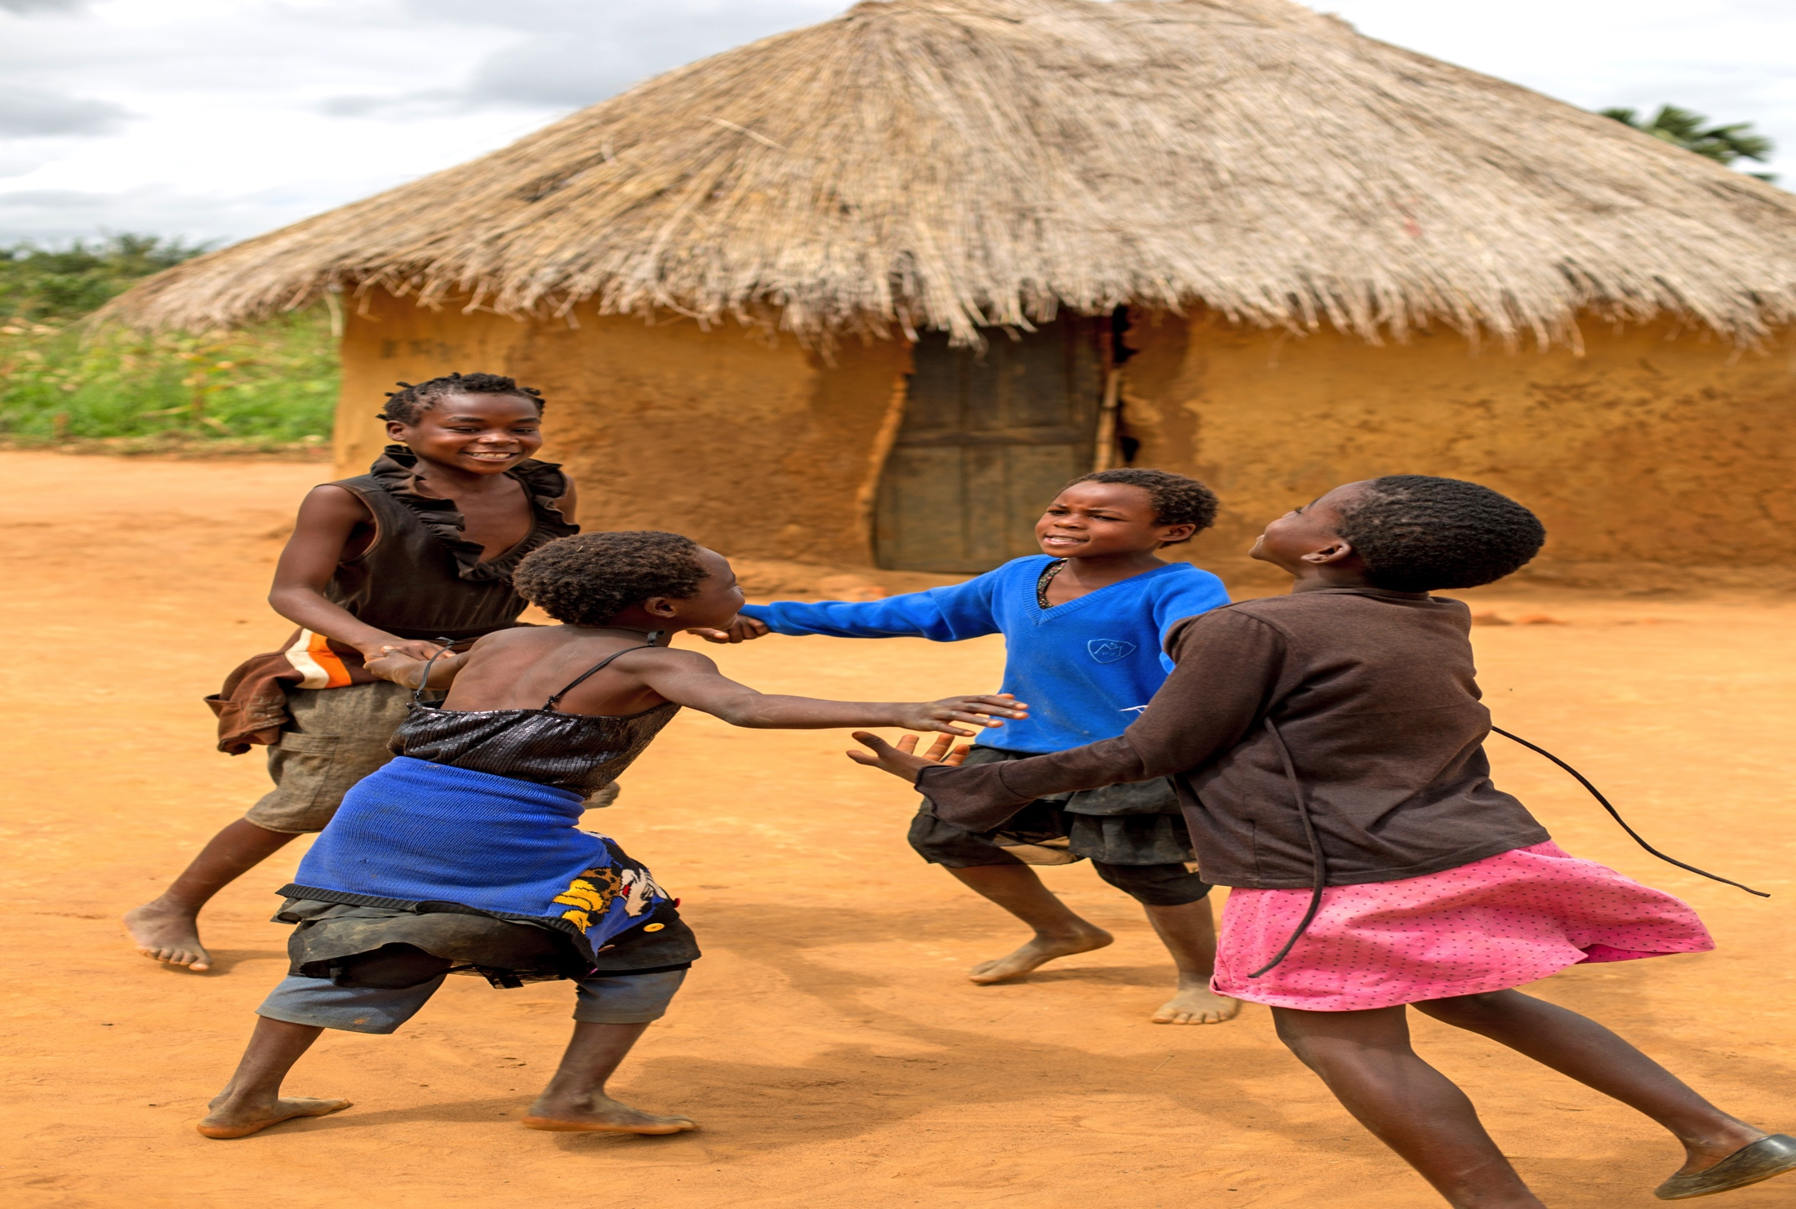
^{SAFE}
^{toward a}
^{WORLD}
^{for}
^{children}
Five-Year Strategic Plan 2016-2021

Slide 2


Secretary General
From the
“Perseverance is more prevailing than violence, and many things which cannot be overcome when they are taken together, yield themselves up when taken little by little.”
Plutarch
Every child has an inherent, universal right to survive and develop, in a life free from violence, abuse, exploitation and neglect. Yet today, more than one billion children – more than half of the world’s children – are exposed to violence each year.

Slide 3
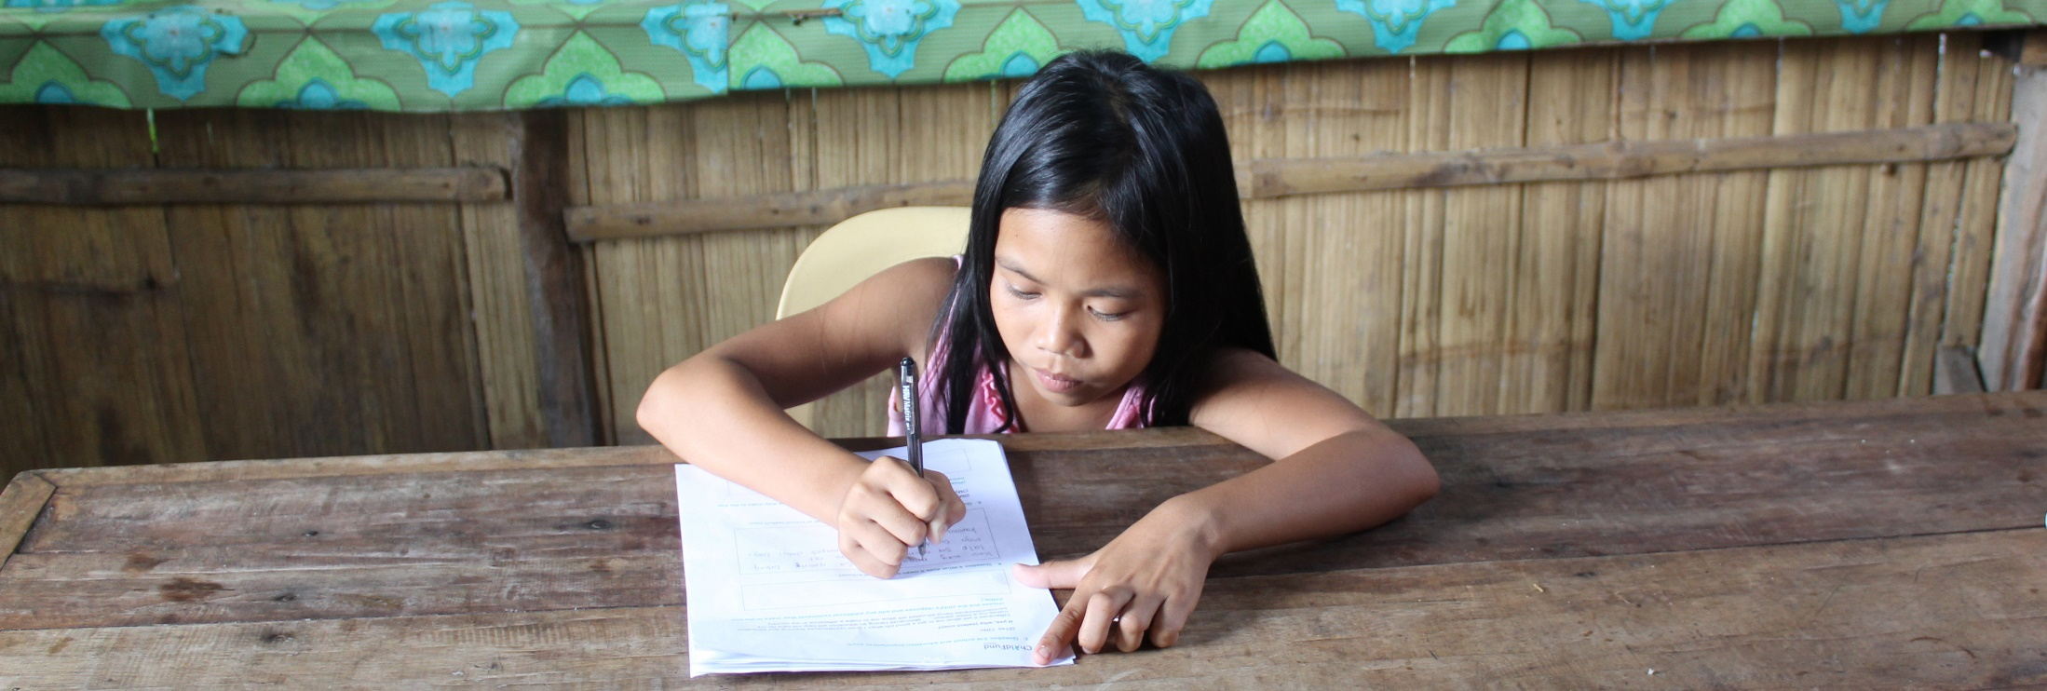
Secretary General (cont’d)
From the
We make a commitment to do all we can to prevent violence at all levels, protect children from violence and exploitation, and enable children to meaningfully participate in decisions related to achieving the Sustainable Development Goals.

Slide 4


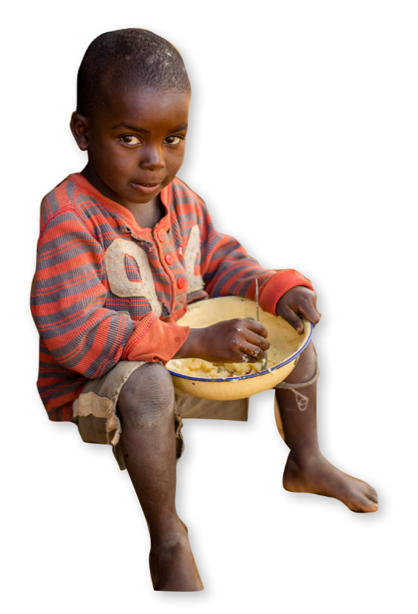
Strategic Plan
at a Glance
A world in which children realize their rights and achieve their potential.
ChildFund Alliance is an effective global network of child-centered development organizations working in the poorest countries around the world to create opportunities for disadvantaged children.

Slide 5
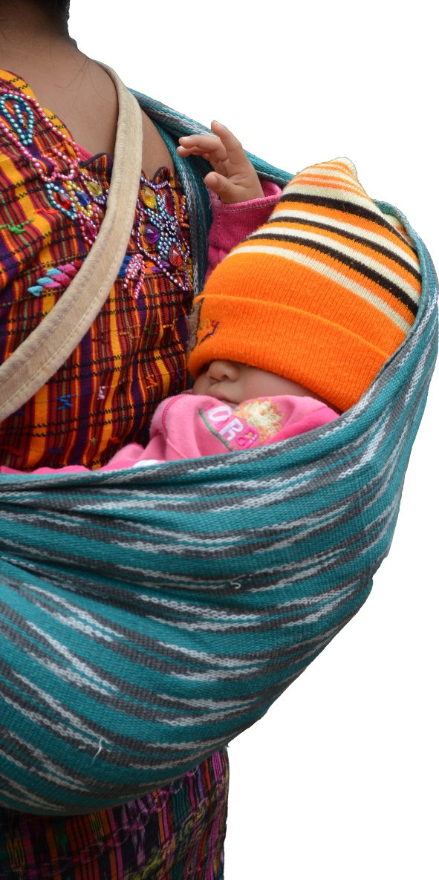

Strategic Plan
at a Glance (cont’d)
Compassion and respect for all children and cultures
Commitment to delivering the
highest quality standards of
integrity and accountability
Collaboration and knowledge-sharing
Advocates for child rights and the interests of all children
Optimism
Connecting People

Slide 6


Strategic Plan
at a Glance (cont’d)
Strategic Priority One
Global Advocacy and Child-Friendly Accountability
Strategic Priority Two
Improve Our Capacity for Child Protection in Emergencies (CPiE) and Disaster Risk Reduction (DRR)
Strategic Priority Three
Strengthen Membership Engagement and Growth

Slide 7
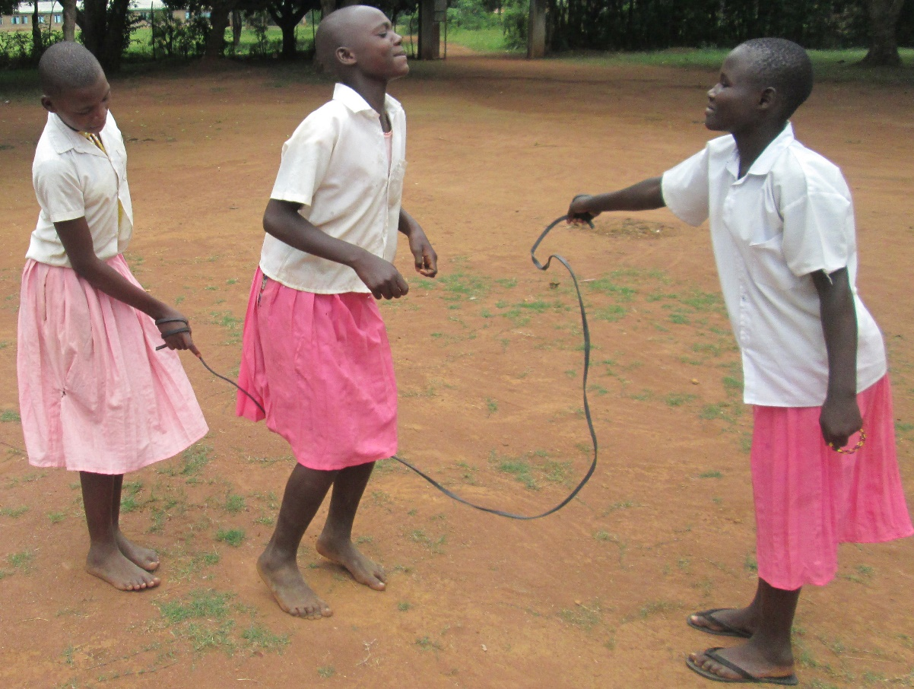
Strategic Plan
at a Glance (cont’d)
We aim to become a global voice with
and for children, to highlight the issues children care about, and to mobilize effectively to address threats to their lives, safety and well-being.

Slide 8

Taking Stock
Key Accomplishments 2012-2015
Transforming Our World: The 2030 Agenda for Sustainable Development is a set of universal goals (SDGs), targets and indicators that frames the global agenda for the next 15 years.
The 2030 Agenda includes a stand-alone target on violence against children: End abuse, exploitation, trafficking and all forms of violence against and torture of children (16.2).

Slide 9

Taking Stock (cont’d)
Key Accomplishments 2012-2015 (cont’d)
ChildFund Alliance actively contributed to positioning SDG Target 16.2 as a core element within the 2030 Agenda.
We achieved this within the context of our three-year global advocacy campaign, free from violence and exploitation, and in close partnership with governments and nongovernmental organizations.

Slide 10
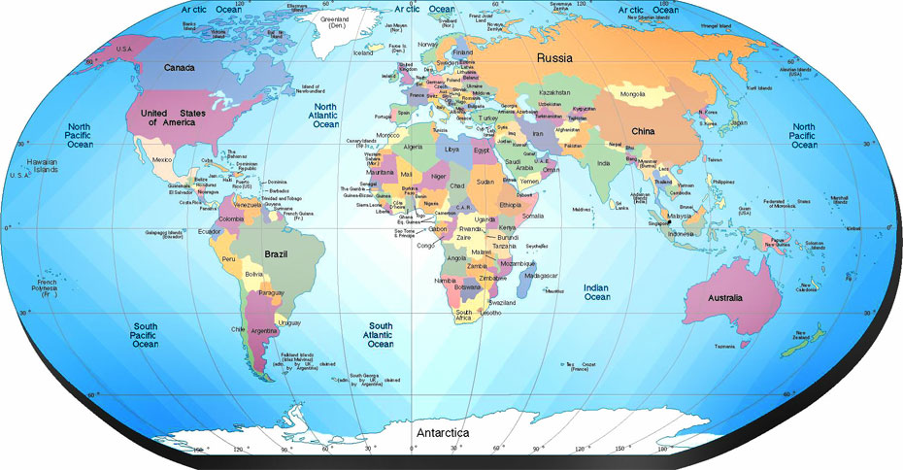
Strategic Priority One
Global Advocacy
For the one billion children who experience violence and exploitation, implementation of SDG Target 16.2 and its related targets is critical.
ChildFund Alliance will work to ensure that these global aspirations are translated into concrete, concerted and definitive actions where our members are active.

Slide 11
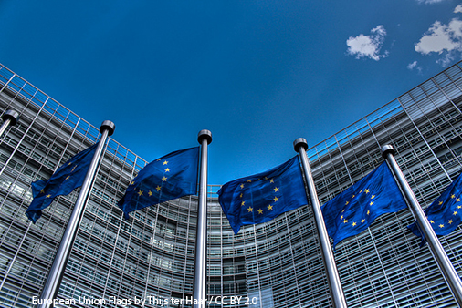
Strategic Priority One
Global Advocacy
We will advance SDG target 16.2 and related targets through global, regional and national advocacy and engagement.
Strengthen advocacy capacity across the Alliance.
Strengthen existing relationships with governments, regional bodies, UN entities
and other stakeholders, and establish new ones based on strategic value.
Strengthen communications to ensure that ChildFund Alliance advocates and speaks with one voice.

Slide 12
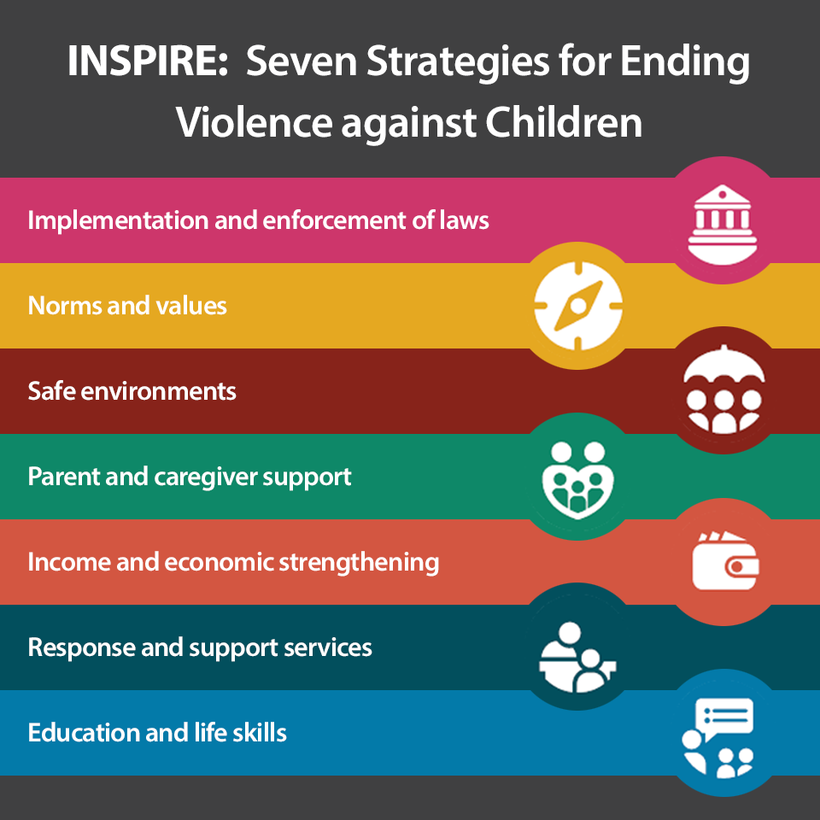
Strategic Priority One
(cont’d)
Global Advocacy (cont’d)
We have defined a series of “Advocacy Asks” that represent the minimum necessary to protect children.
These include endorsing and implementing the INSPIRE package of strategies advanced by WHO and partners that have shown success in reducing violence against children, as shown in the diagram at right.

Slide 13
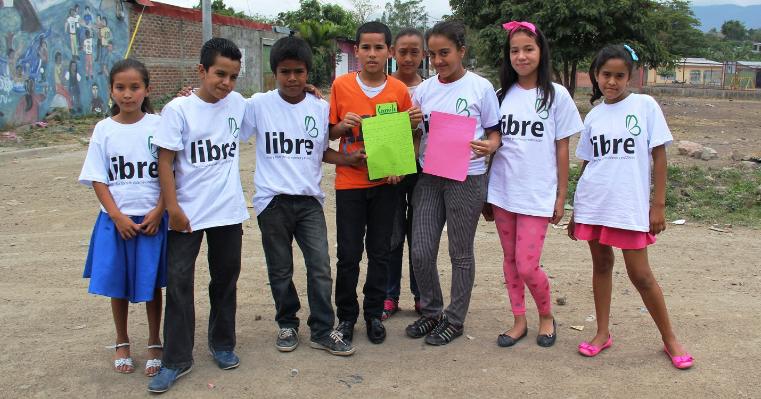
Strategic Priority One
(cont’d)
Child-Friendly Accountability
Child-Friendly Accountability, in its most simple form, is the ability to make certain that those charged with protecting and fulfilling children’s rights actually do what they are supposed to do, and if they do not or cannot, that children and their representatives have some recourse.

Slide 14
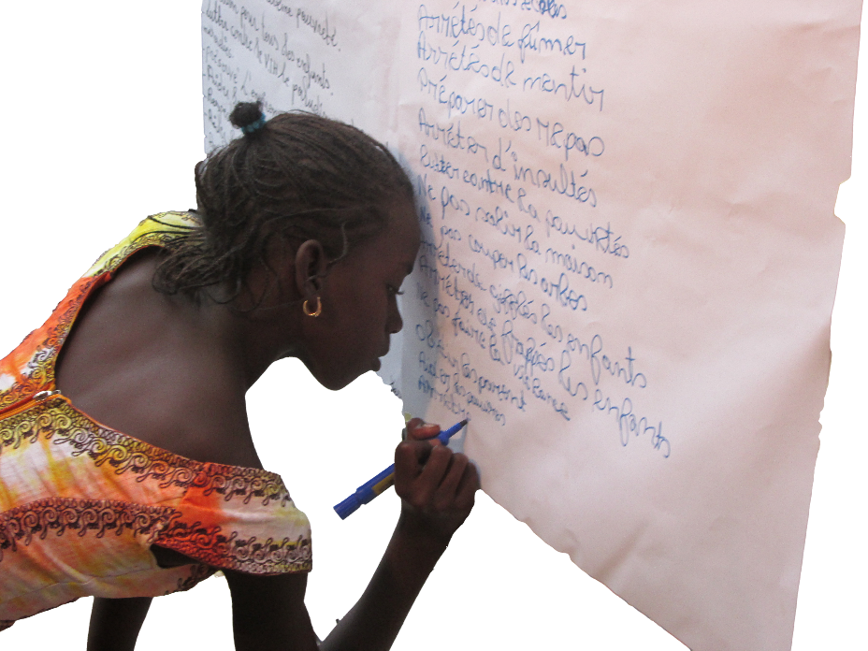
Strategic Priority One
(cont’d)
Child-Friendly Accountability (cont’d)
From 2016 to 2021, ChildFund Alliance will:
help children access age-appropriate data and information and contribute to monitoring child protection systems;
support children in holding their governments and local authorities accountable to their commitments in SDG target 16.2; and
advocate for international, national and local systems and policies focused on eliminating violence against children, including mechanisms to monitor and respond to cases of violence against children.

Slide 15
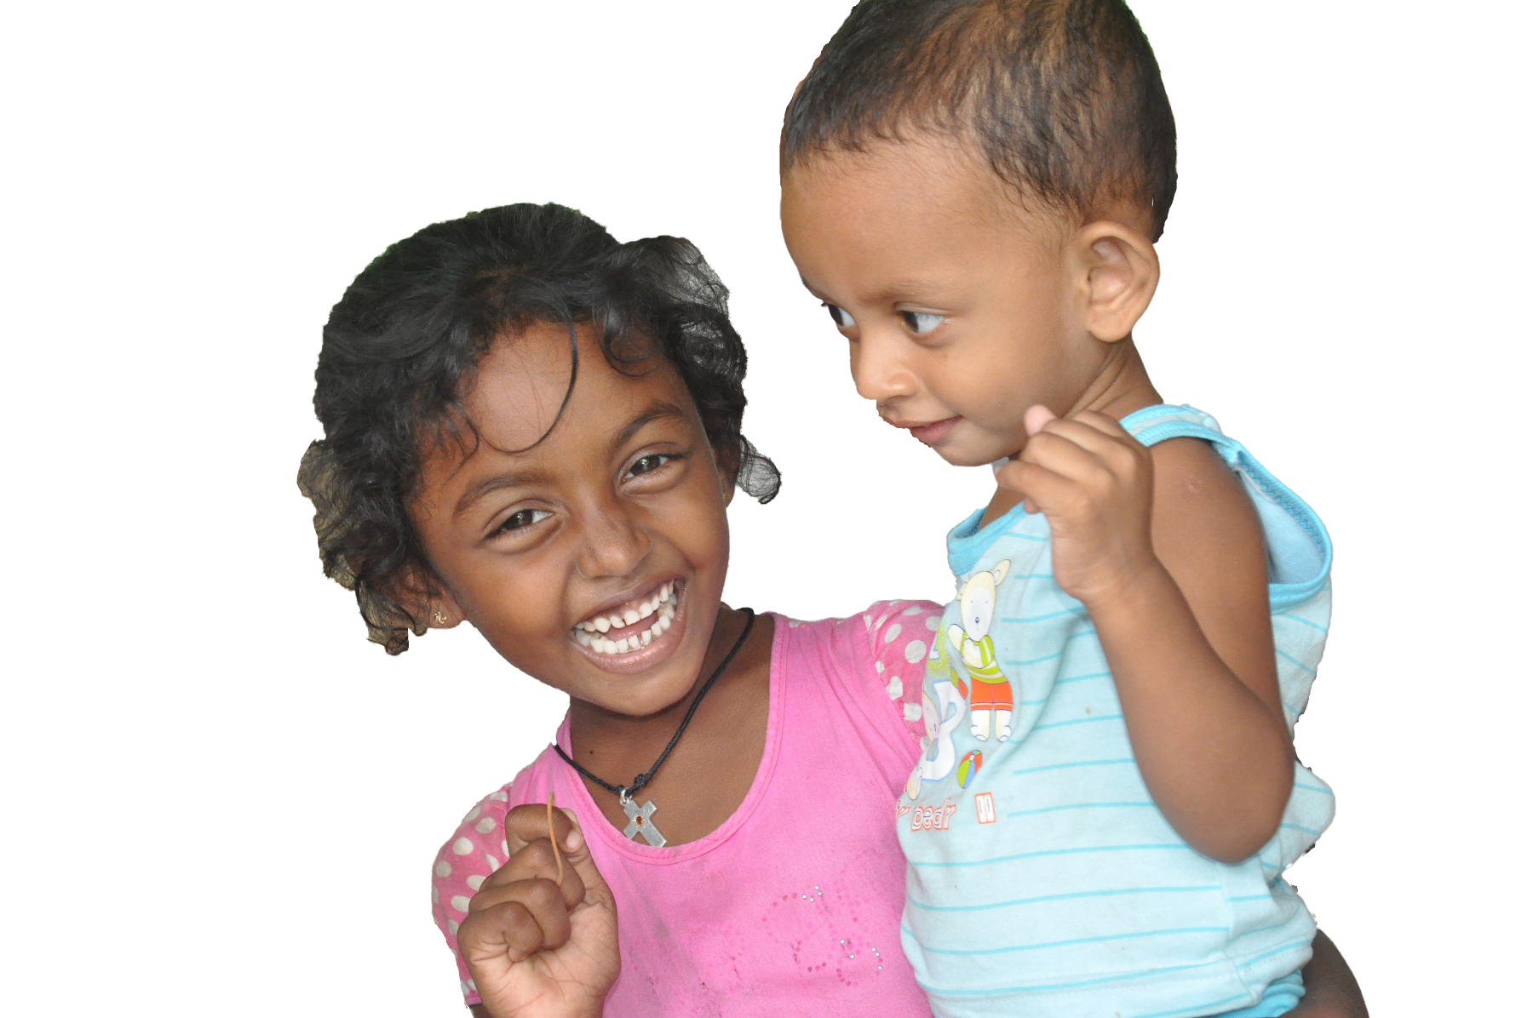
Strategic Priority Two
Child Protection in Emergencies
In times of crisis, children face an increased risk of all forms of violence and exploitation, including family separation, trafficking, recruitment in armed forces, and physical and sexual abuse.

Slide 16
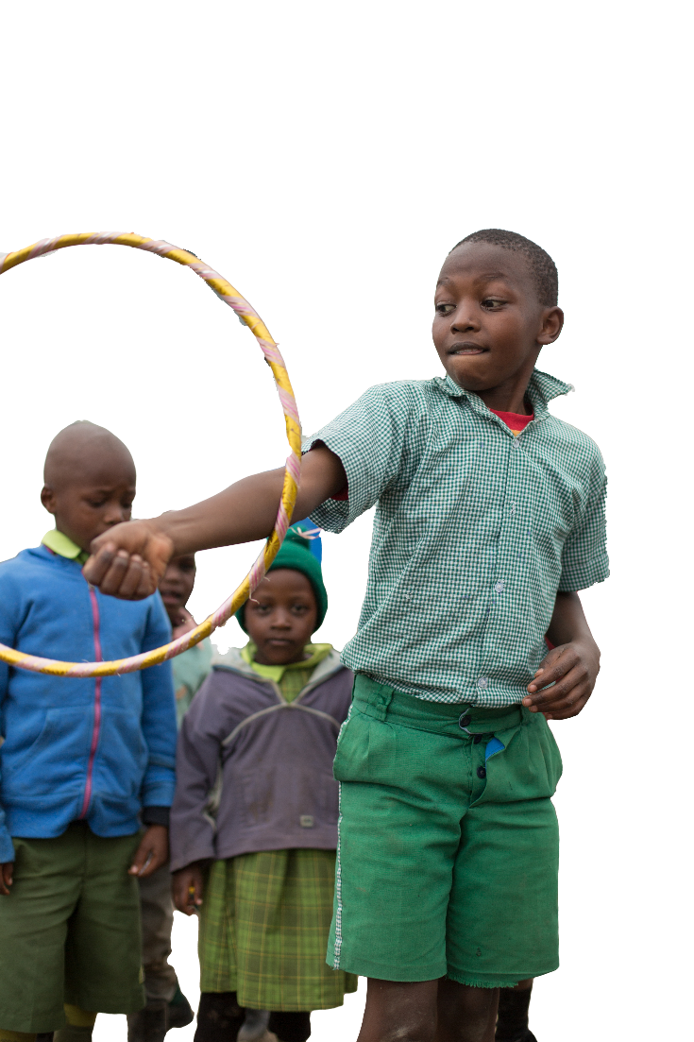
Strategic Priority Two
(cont’d)
Child Protection in Emergencies (cont’d)
Child protection in emergencies seeks to reduce violence, exploitation and abuse through support services, such as providing safe spaces for children, and working with community-based institutions.
      From 2016 to 2021, ChildFund Alliance will:
      prioritize key child protection in emergencies interventions in all humanitarian response; and
      improve Alliance-wide response for large-scale emergencies.

Slide 17
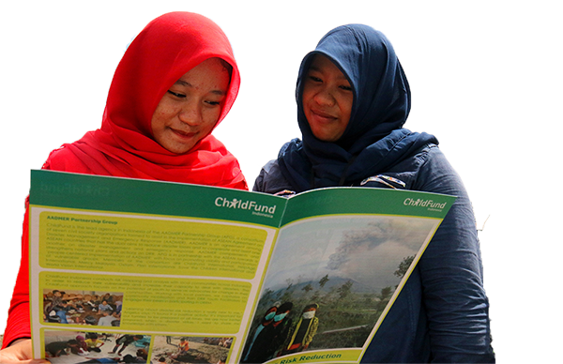
Strategic Priority Two
(cont’d)
Disaster Risk Reduction
A disaster can change a child’s life in a matter of minutes, and wipe away positive impacts that took development programs years to achieve. Preventing or reducing disaster risks and addressing their immediate effects and long-term impact is an imperative.

Slide 18
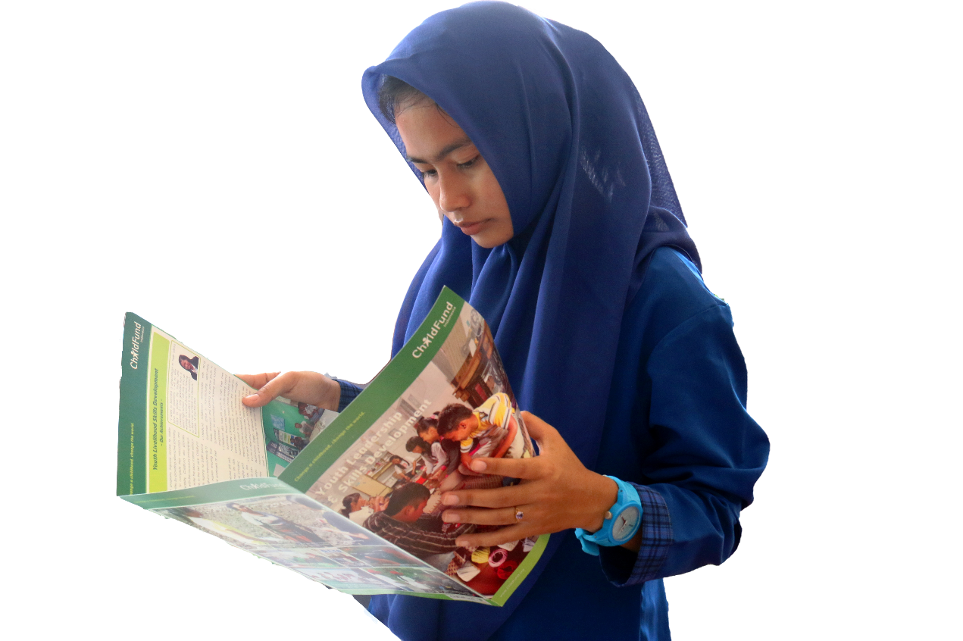
Strategic Priority Two
(cont’d)
Disaster Risk Reduction (cont’d)
From 2016 to 2021, ChildFund Alliance will:
build on successful youth-led disaster risk reduction models; and
mainstream disaster risk reduction into regular programming and community development.

Slide 19
Strategic Priority Three
Strengthen Membership Engagement & Growth
Over the next five years, ChildFund Alliance will recruit at least three new members based on concrete partnership opportunities at the field level.

Slide 20
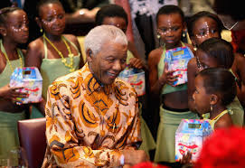
“Many who live with violence day in and day out assume that it is an intrinsic part of the human condition. But this is not so. Violence can be prevented. Governments, communities and individuals can make a difference...”
Nelson Mandela

Slide 21

“Toward a Safe World for Children:
Five-Year Strategic Plan 2016-2021”
childfundalliance.org/strategic-plan

